Slide 1
Asking for Help Update Reducing Data Needed
Michael & Wesley

Slide 2
Problem Statement
Assumptions
Model Free
No Access to Reward Function
High Dimensional State (i.e. image size)
Access to Expert Demonstrator or Oracle
Objective
Reduce the expected number of mistakes the robot makes
Learn a policy at a similar learning rate of a state of the art method

Slide 3
GPS vs. DAgger
GPS
Assumptions
Full hidden state known
Known Smooth Reward Function
Dagger
Assumptions
Works on Partial Observations
Expert Demonstrator

Slide 4
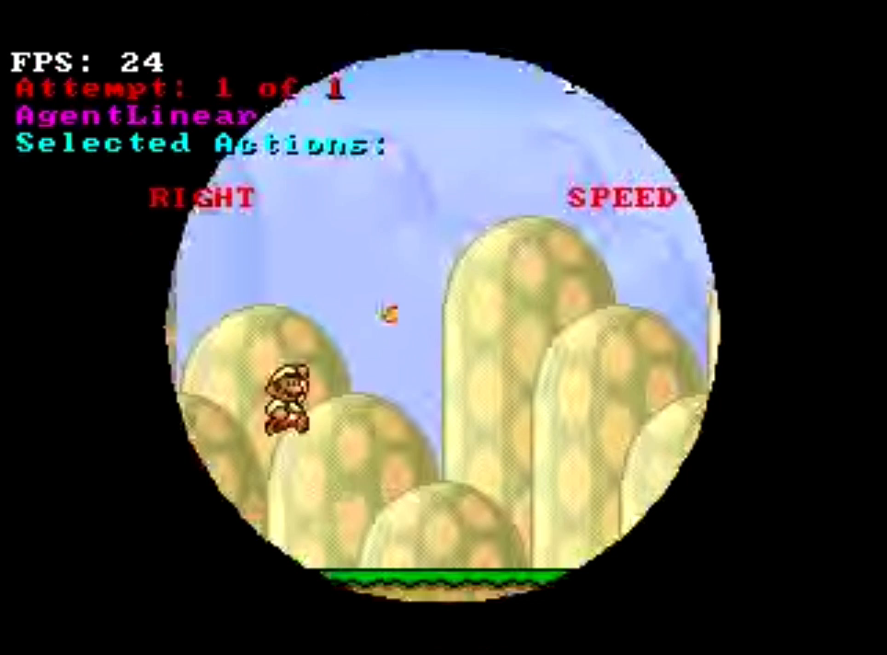
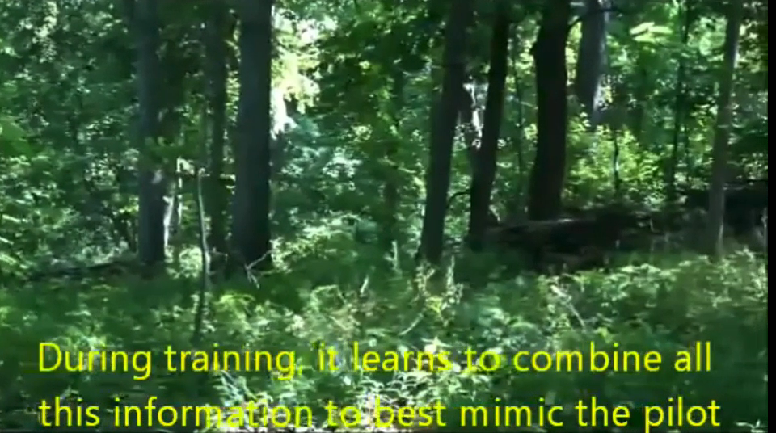
DAgger
[Ross et al. 11’]
[Ross et al. 13’]

Slide 5
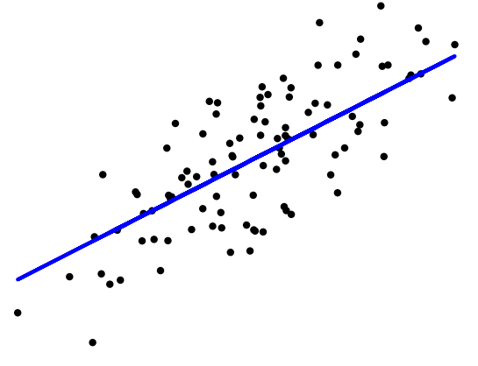
DAgger
Train Estimator
Collect Samples
Expert Labels
Samples

Slide 6
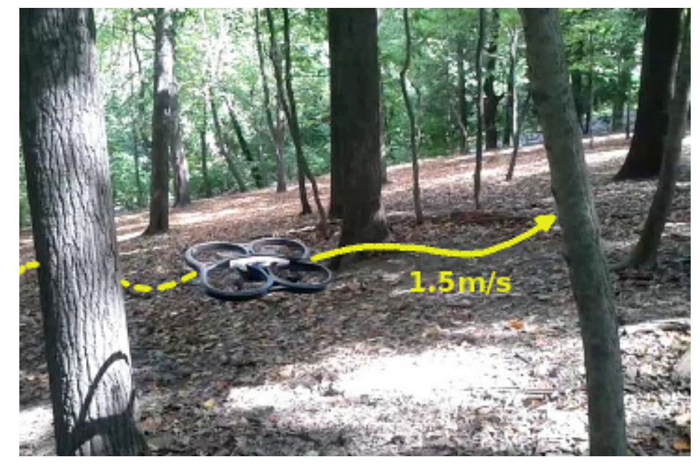
Dagger Limitations

Slide 7
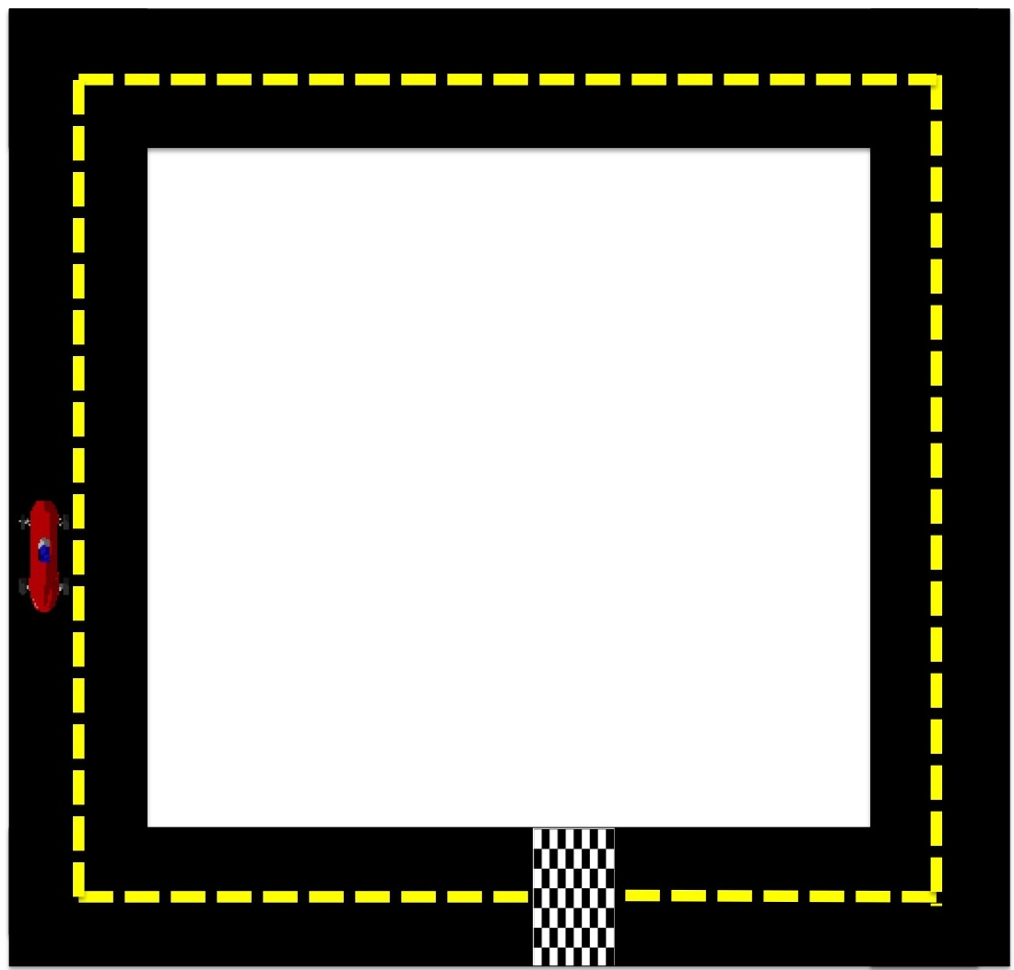
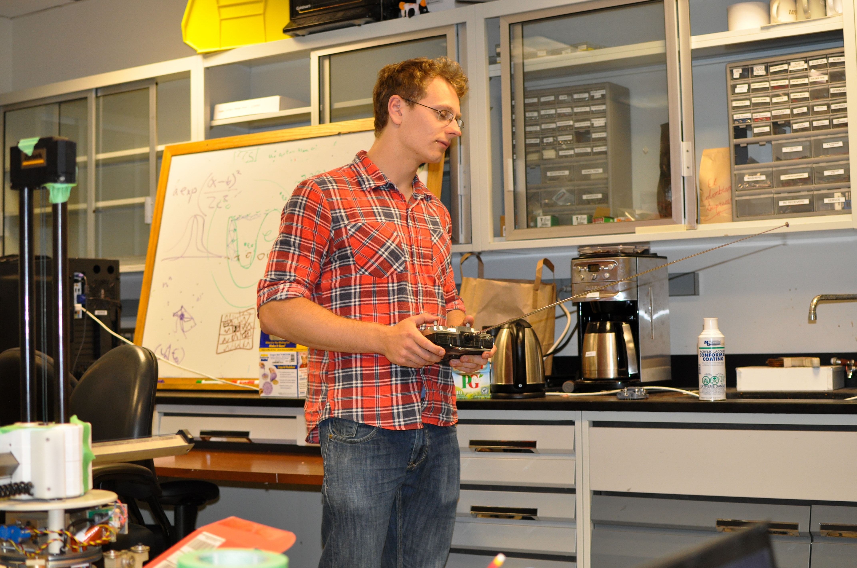
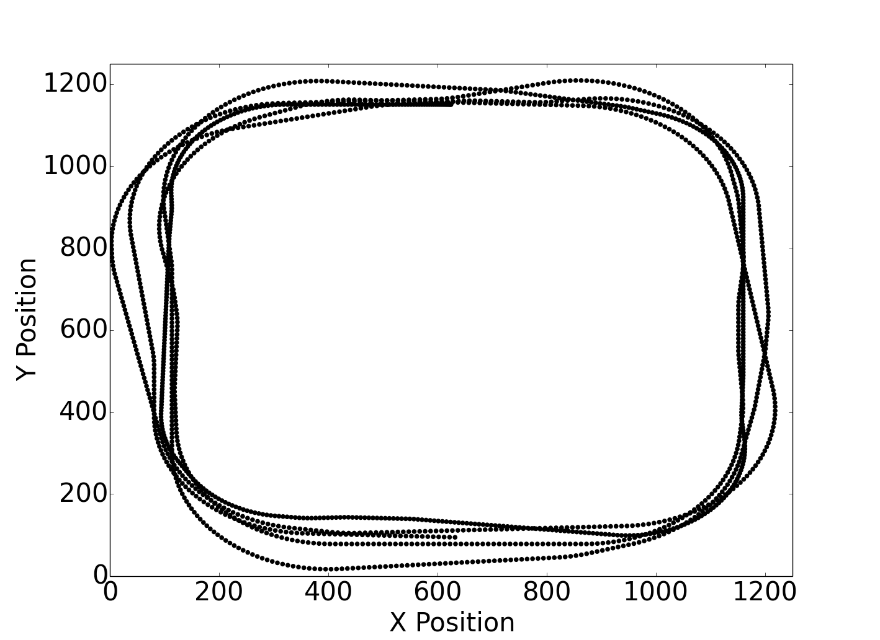
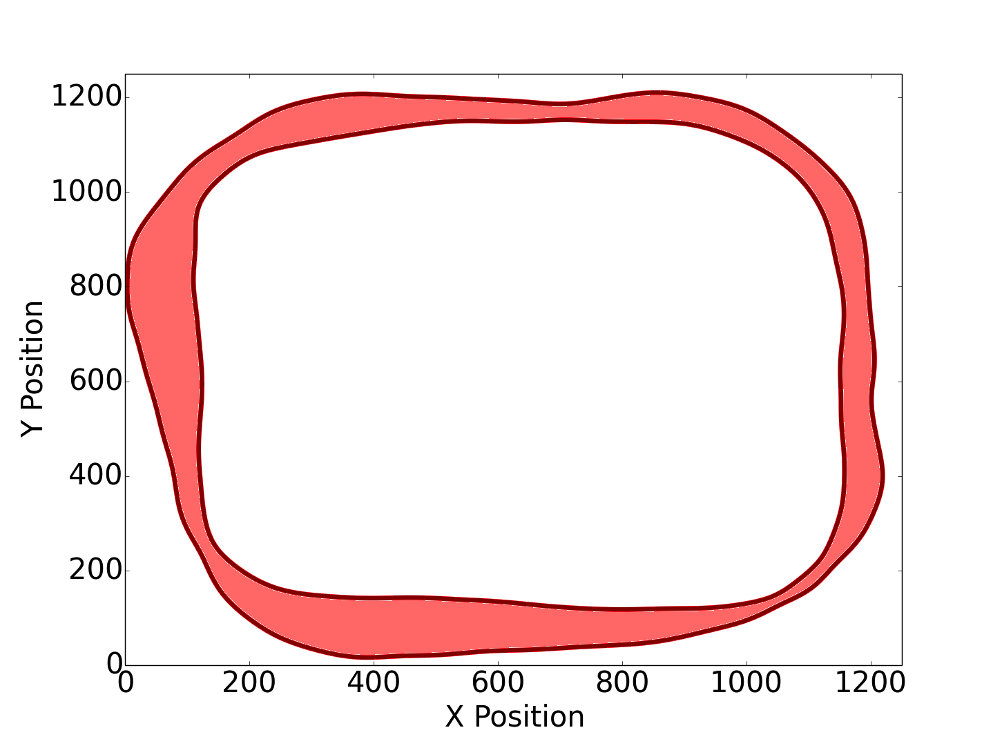
RC Car
Expert
Expert Demonstrations
Estimated Support
(OC-SVM)

Slide 8
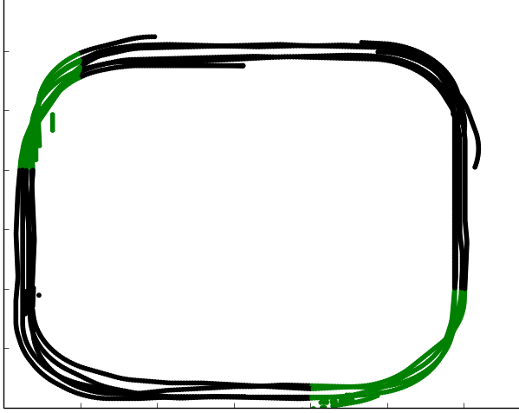
Labels are Needed Within Support
Dagger and AHUSE require examples to be provided to correct for incorrect classifiers
Mislabeled Areas

Slide 9
OneClass SVM

Slide 10
Modified OneClass

Slide 11
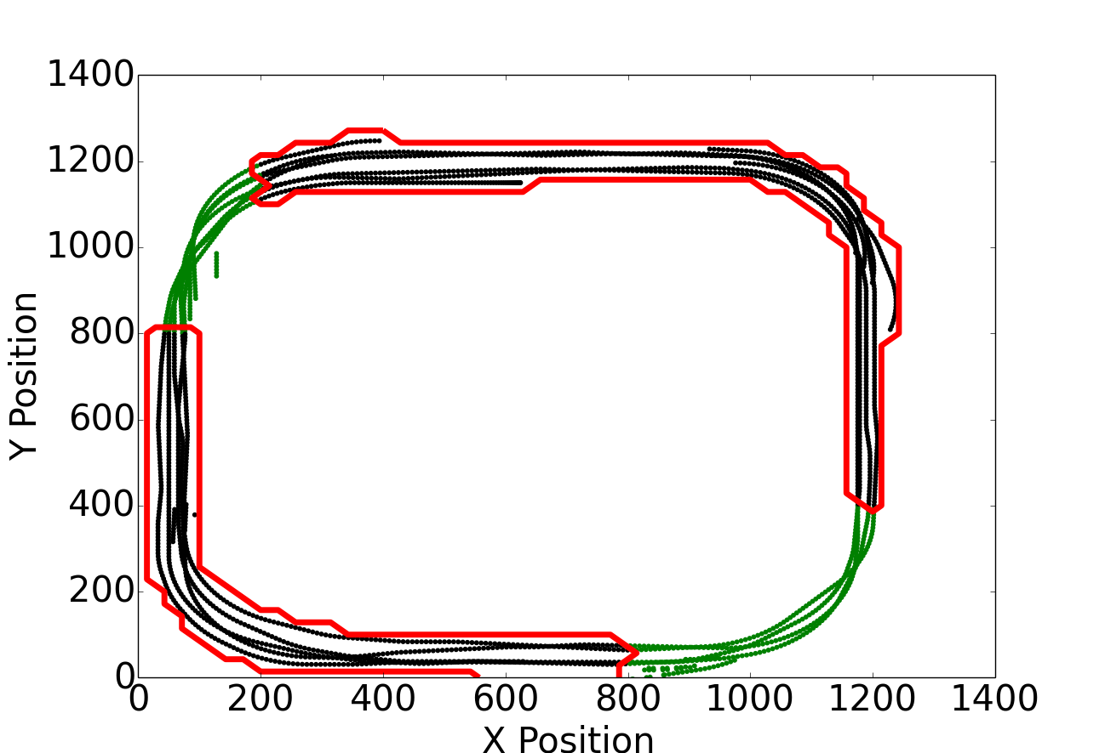
Results on Toy Example

Slide 12
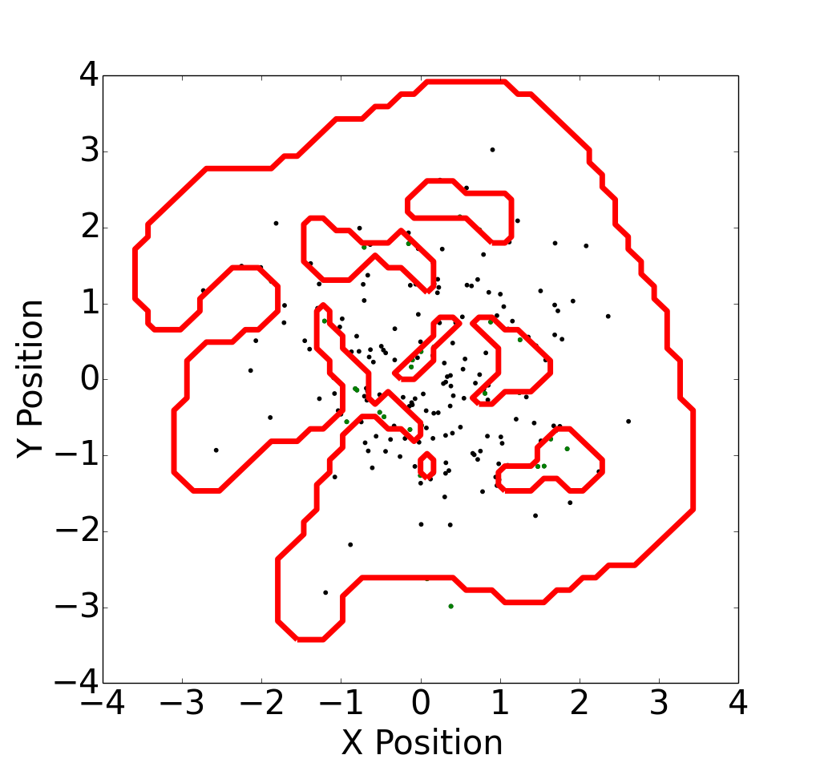

Slide 13
Backup

Slide 14
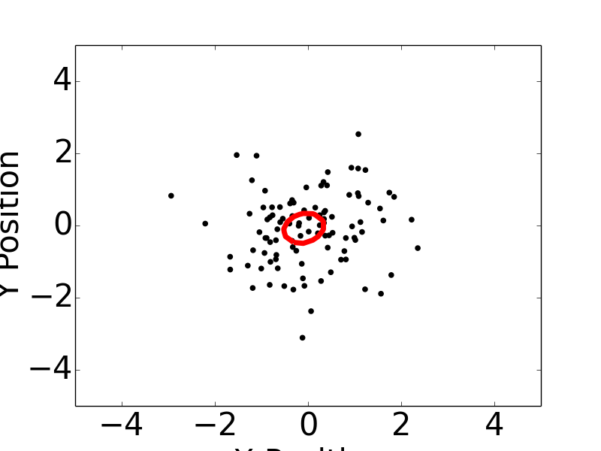
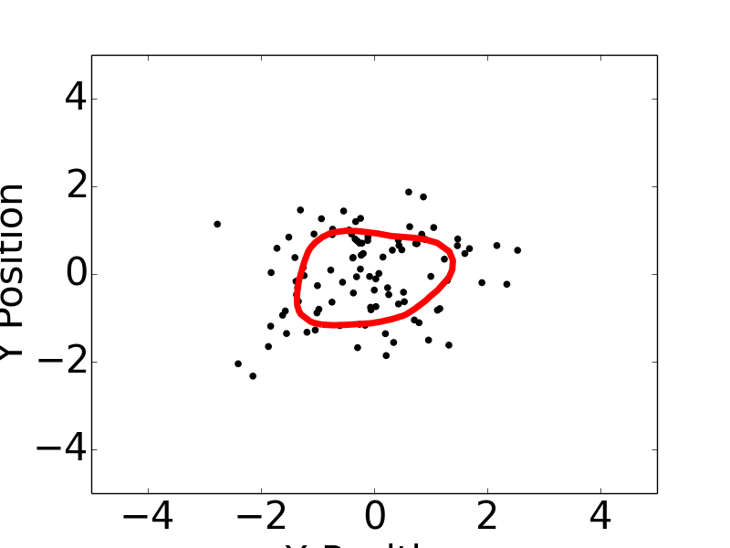
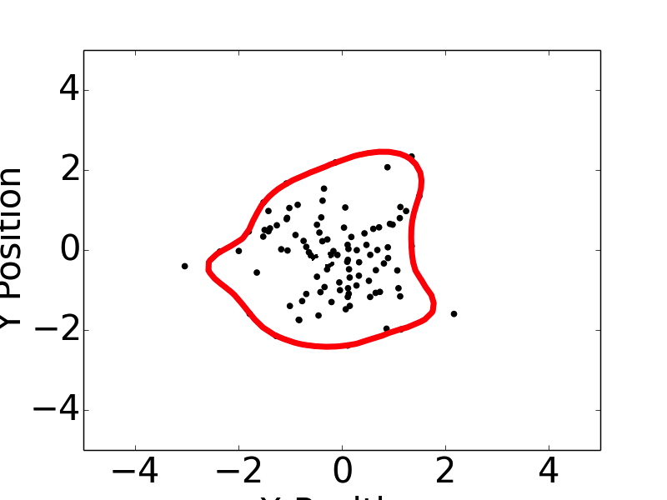

Slide 15
Dagger Limitations

Slide 16
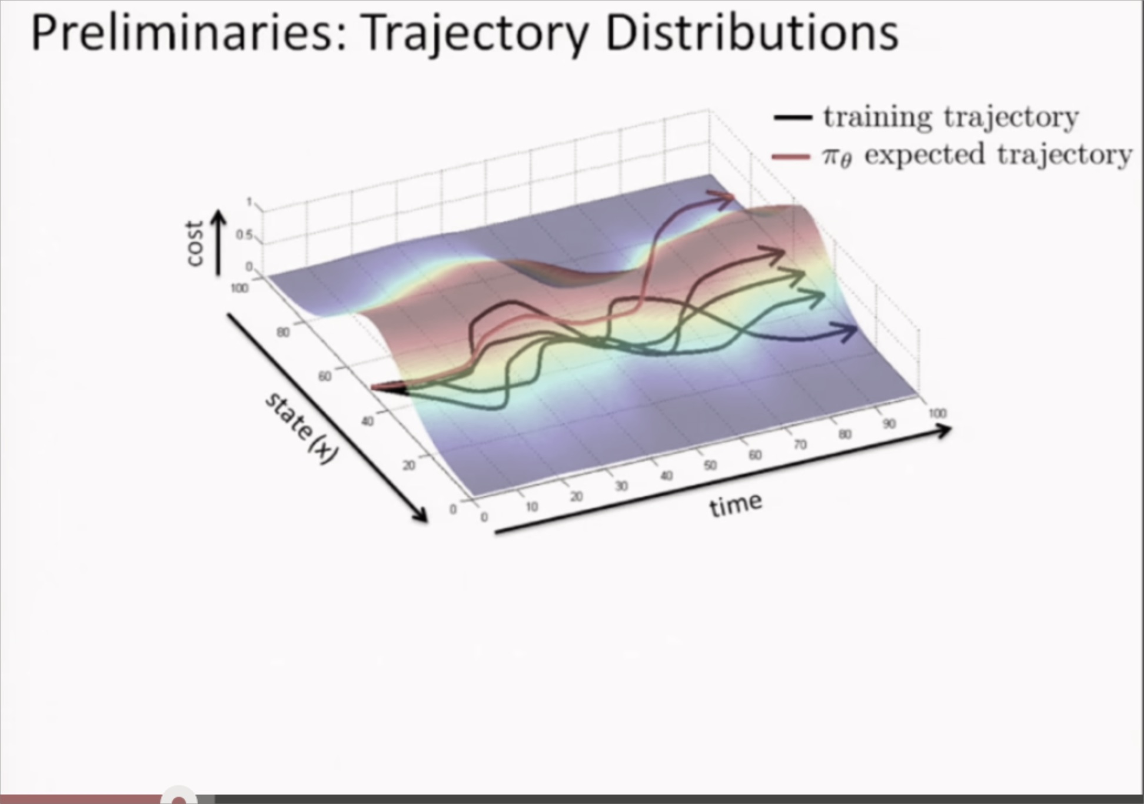
Asking For Help
Robot can consult and expert, when unsure what to do
Estimate density trained on and when states have low probability ask for help
[Levine et al. 14’]

Slide 17
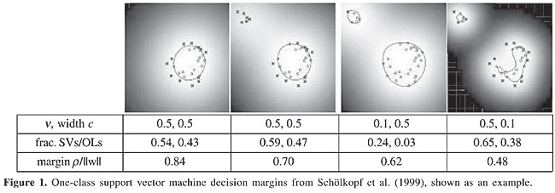
Estimation of Support
Density Estimation performs badly in high dimensions
Minimax theory provides rate of mean squared error is
Solve easier problem by estimating a level set of the probability distribution
One Class SVM
Parameter controls the amount of probability contained in the level set

Slide 18
Expert Label

